Slide 1
Data Cleaning
Jasyot Gaur

Slide 2
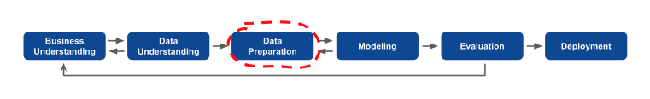
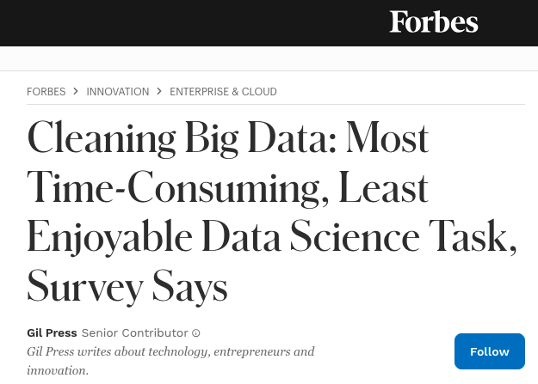
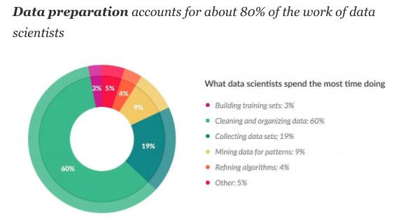
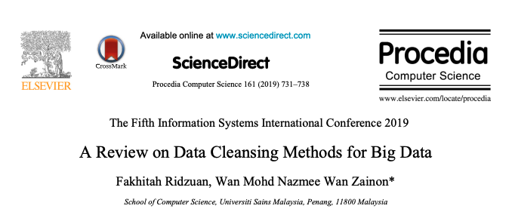
CRISP - DM
Cleaning of dataset, transforming it in such a way that it can be used as an input to a machine learning model.
Notes:
Cross-Industry Standard Process for Data Mining. It was invented quite long ago, in 1996, but in spite of its age, it’s still applicable to today’s problems.
You have more and more data generating every second and the problem to get a dataset that can be used as an input to ML algo is getting difficult. As it takes time and computing resources to do the same.

Slide 3
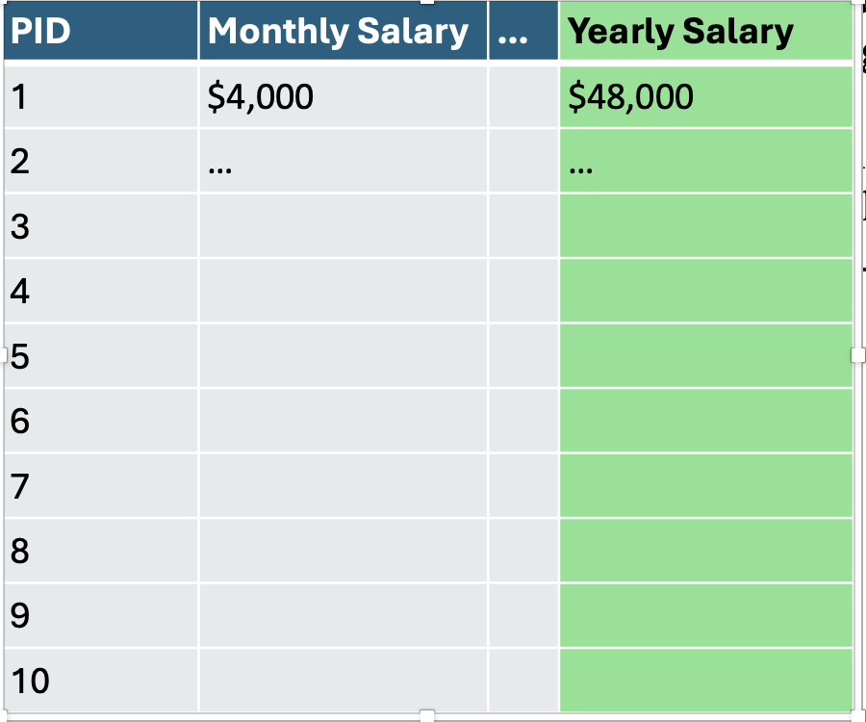
Data Cleaning Framework
Basic Cleanup:
Reindexing.
Date Time format.
Data Types and Values
Duplicate Records
Scaling:
MinMax
Normalization
BoxCox
Data Leakage and Class Imbalance:
Remove any feature that capture information of target.
Target Leak: Features having info regrading the target.
FE before split
Irrelevant or Redundant Features:
Business
Correlation
Handling Categorical Values:
O.H.E
Label Encoding
NLP
Use Advance Model Algo.
Check on Outliers:
Remove if linear model.
Z-Score
One-Class SVM (Advance)
Missing Value Handling**:
Imputation.
Use Advance Algo.
Notes:
One-Class SVM (Advance): For more advanced machine learning-based methods like Isolation Forest or One-class SVM, you'll need to train a model on your dataset and then use the model to detect outliers.

Slide 4
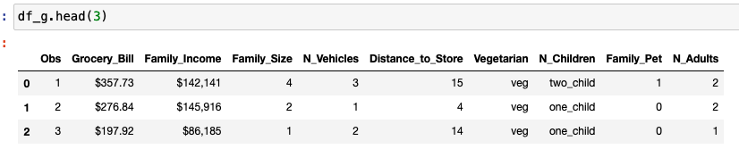
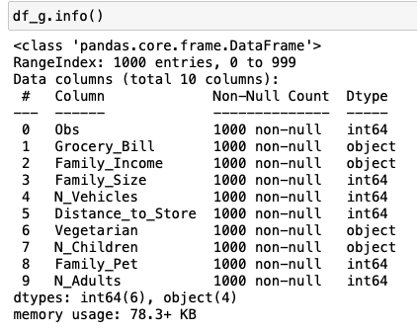
1. Basic Cleaning: Grocery Dataset
What you guys think needs to be fixed?
No missing values – That’s great!
Bill is an object datatype
Income is object datatype
N_Child is object datatype
$ sign in income and bill
“,” in family income
Notes:
Bill and Income are object type data it should be an int or float
“$” and “,” Needs to be removed from Income and “$” from Bill.

Slide 5
1.1 One Hot Encoding
Encoding: Turning categorical feature into numeric features
OHE
Ordinal Encoding (Not recommended)
[DT’s, Boosting’s, Bagging]
OHE: Create new numeric feature for each level of categorical feature
PID | Province | …
1 | ON
2 | QB
3 | AB
4 | ON
5 | ON
6 | BC
7 | AB
8 | BC
PID | Province_QB | Province_AB | Province_ON | Province_BC | …
1 | 0 | 0 | 1 | 0
2 | 1 | 0 | 0 | 0
3 | 0 | 1 | 0 | 0
4 | 0 | 0 | 1 | 0
5 | 0 | 0 | 1 | 0
6 | 0 | 0 | 0 | 1
7 | 0 | 1 | 0 | 0
8 | 0 | 0 | 0 | 1

Slide 6
Exercise
Clean the Grocery data set. Do the following:
Remove $ and , from income.
Remove $ from Bill
Convert Income and Bill as float datatype.
Hint:
Data frame feature ->str.replace (what you want to replace, what you want to add)
Replace any white space using the same function
Convert the final series as float data type.

Slide 7
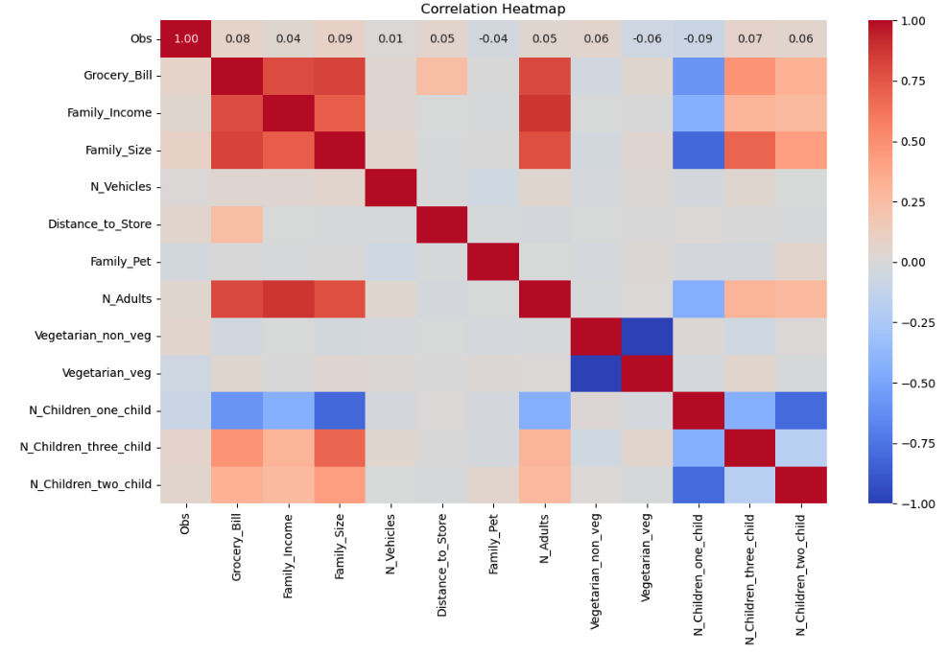
2. Redundant Features: Grocery Dataset
Drop the following features from your dataset:
Don’t make sense to business
Huge variations
Not correlated with target
Notes:
In credit default model or any model that is in direct consideration of user data. We delete the feature of Gender. Its done so that model show any bias to any specific gender.

Slide 8
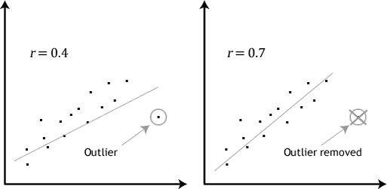
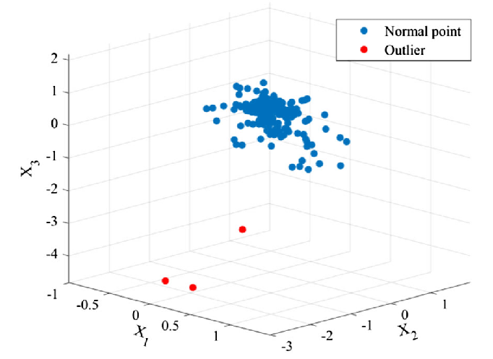
3. Outliers
Types of Outliers
Univariate: Single dimension is very large on its own.
Multivariate: Interaction of two+ dimensions.
Notes:
Univariate: High income in Canada that is more than 450k.
Multivariate: High income in Canada, age is 7 years and the income is 500k.
Outlier impacts your over all model predictions and thus needs to be either removed or include with caution.

Slide 9
3.1 How to Find Outliers?
Methods to find Outliers:
Statistical information of data-frame df.describe ().
Perform this function for grocery dataset and try figuring out which feature might have outliers.
Scatter plots etc.
Regression Plots (Q-Q Plots).
Data Distributions.
Note: Univariate are easy to find and Multivariate are hard to find (regression plots helps)

Slide 10
Code Demo1: Basic Cleaning and Heatmap

Slide 11
Exercise
Load your project dataset in pandas.
Do OHE for all the categorical variables in the data-frame.
Generate the heatmap and drop the features that don’t move with target (optional)

Slide 12
4. Missing Values
ID | Age | Gender | Income | Status | Children | Job | Buy?
1 |  | A | 150,000 |  | 1 | Engineer | No
2 | 27 | B | 50,000 |  |  | Teacher | No
3 |  | A | 100,000 | Married | 2 |  | Yes
4 | 25 | B |  |  | 2 | Engineer | Yes
5 | 35 | B |  | Single | 0 | Doctor | Yes
6 |  | A | 50,000 |  | 0 | Teacher | No
7 | 33 | B | 60,000 | Single |  | Teacher | No
8 | 20 | B | 10,000 |  |  | Student | No
MNAR: Missing Not at Random
Value is missing because of itself (Income)
MAR: Missing at Random
Value is missing due to a value of another feature (Age is always missing when gender is A)
MCAR: Missing Completely at Random
No pattern what so ever!
Manually Fix (use mode or median)
Advance Algo’s
Manually Fix (use mode or median) or Algo’s
Notes:
KNN Imputation is a good option

Slide 13
4.1 Little’s Test
We will cover this in statistics!

Slide 14

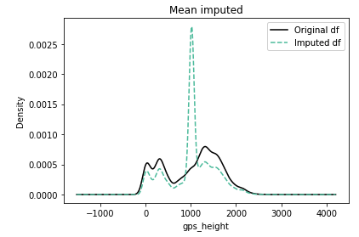
4.2 Imputation Insights
Q: How would you impute a missing value in Price?
Do not just impute by mean/mode/median blindly.
Check what type of missing value your data has.
Type of Missing Data | Chances of Distortion
MNAR | High
MAR | Medium
MCAR | Low
Probability of distortion using mean imputation.

Slide 15
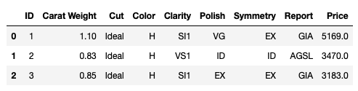
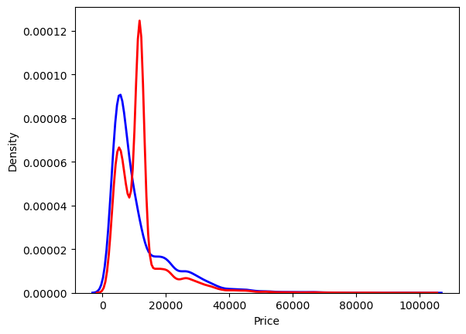
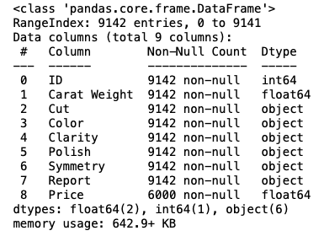
4.2 Data Distortion: Diamond Dataset
Blue Original
Red Mean Imp.

Slide 16
4.3 Points to Ponder
Try not to drop missing values from your dataset, why?
If dropped missing values, always re-set your index.
Some advance techniques to handle missing values are:
Create a new feature (Boolean) in your dataset showing if a value is missing for a feature/row.
Use DT’s, Boosting (XGBOOST, CATBOOST, LIGHTGBM).

Slide 17
Code Demo2: Handling Missing Values

Slide 18
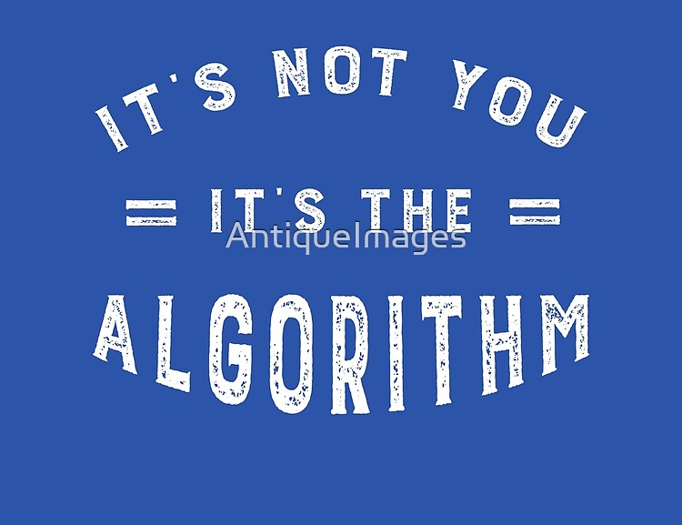
4.4 Advance Algo.
MICE (Regression, Bayesian)
KNN (Frequency based)
MissForest (Random Forest)

Slide 19
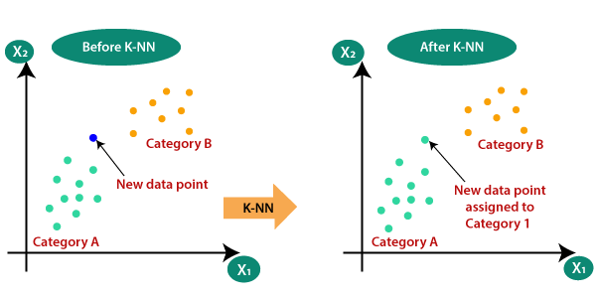
4.5 KNN
KNN: K - Nearest Neighbors.
Algo predicts the new data point based on what classes are closets.
No training required to make predictions.

Slide 20
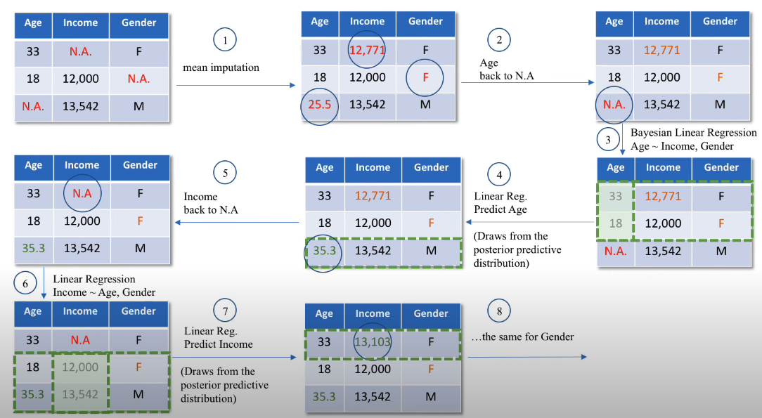

4.6 Multiple Imputation by Chained Equations (MICE)

Slide 21
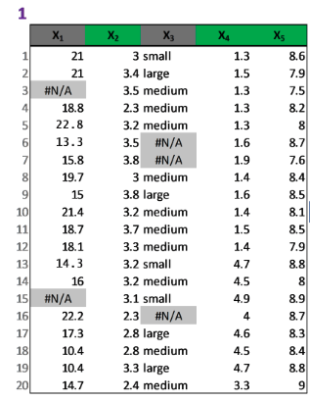
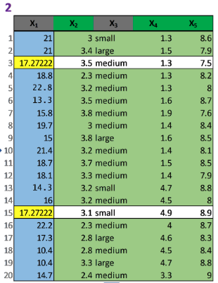
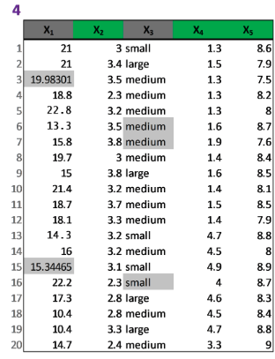
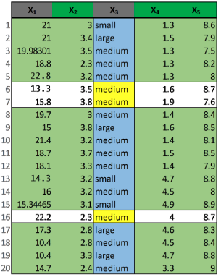
4.7 MissForest
Built on the top of random forest algo.
Missing values replaced by mean/most frequent value.
Data is split up as observed (train) missing (predictions)
Final dataset is created when model converges.
Notes:
Step1: replace the missing value by mean of numerical and freq of categorical data
Step2: For each variable, a random forest regressor is trained on observed data and make predictions for the missing dataset value

Slide 22
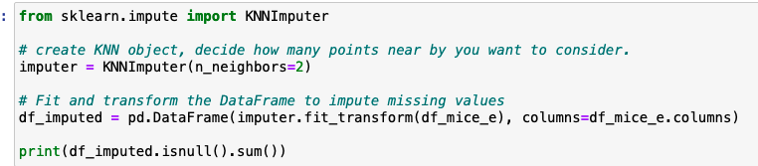
Running KNN

Slide 23
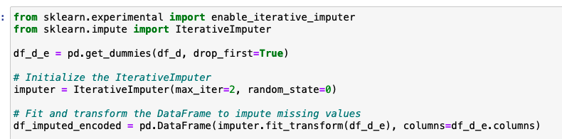
Running MICE

Slide 24
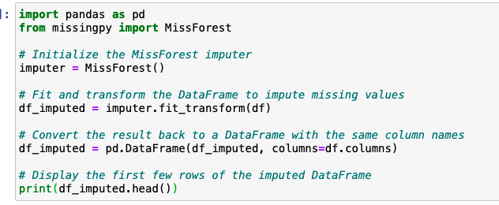
Running MissForest
You can add number of Iterations needed
Can get dependency error. Use the following before importing: Importing missingpy it tries to import automatically 'sklearn.neighbors.base' however in the new versions of sklearn it has been renamed to 'sklearn.neighbors._base'
import sklearn.neighbors._base sys.modules['sklearn.neighbors.base'] = sklearn.neighbors._base

Slide 25
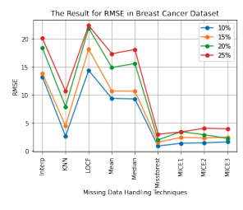
4.8 What To Use?
KNN has seen success but requires tuning of the parameter k and additionally, is vulnerable to outliers.
MICE is very expensive to run.

Slide 26
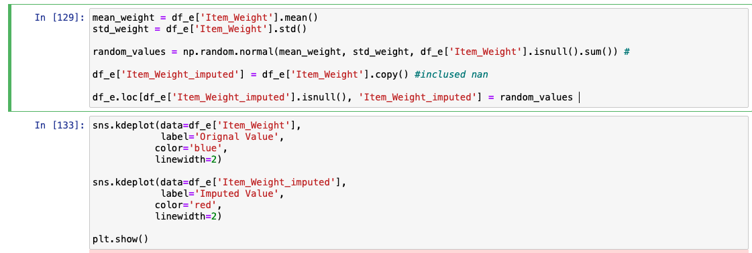
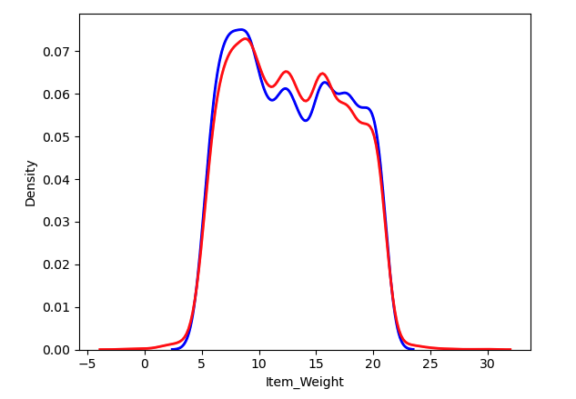
4.9 None Makes Sense?

Slide 27
Code Demo3: Advance Methods Handling Missing Values

Slide 28
5. Feature Engineering
Feature Engineering is the creation of new features in your dataset to make sure machine learning algorithm learns better.
Transformation is nothing but Feature Engineering Steps.
Feature Engineering is Machine Learning, agree? Thoughts?
Frequently used FE steps:
Scaling: Log, Standardize, minmax
Non-Linear: 1/x, x^2, |x|, sin(x)
Dimensionality Reduction: PCA
Embeddings: Word2Vec, TFIDF

Slide 29
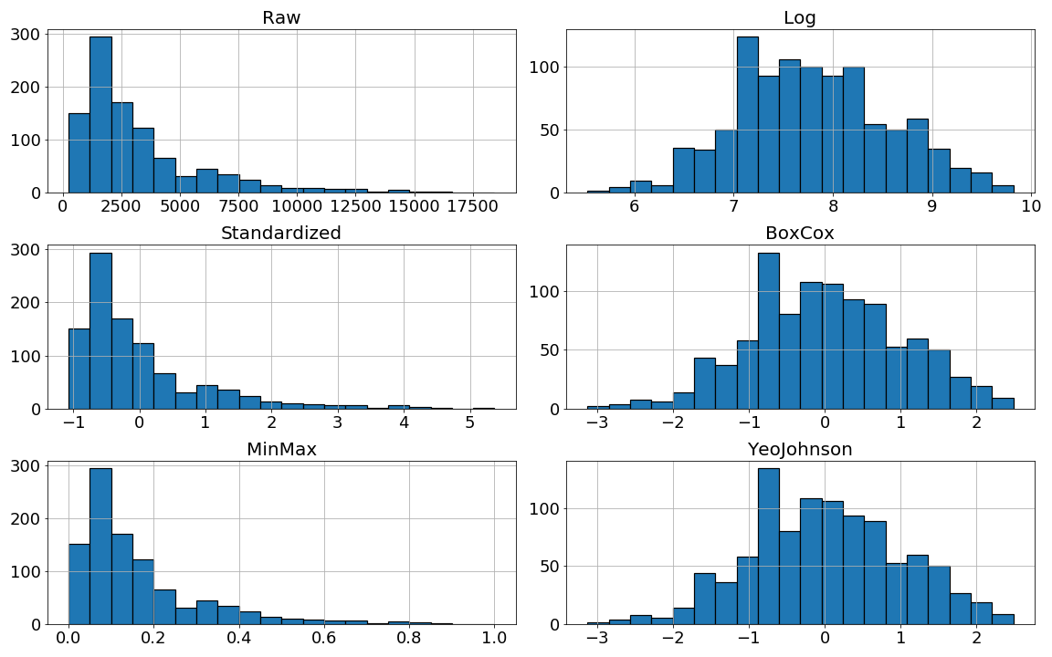



5.1 Scaling
Scaling: Any transformation that changes the values of a feature to either fall within a different range, or have a new distributional shape, or both.
$$X_{new}=\ln\left(X_{old}\right)$$
$$X_{new}=\frac{X_{old}−μ}{σ}$$
$$X_{new}=\frac{X_{old}−min}{max−min}$$
Notes:
Scaling = changing scale or distribution or both
MinMax - Scales data to be within [0, 1] Results: Scale changes, distribution shape doesn't change
Normalization – Centers around zero, and divides by standard deviation. Results: Scale changes, Distribution shape doesn't change
BoxCox – Reduces skew and transforms into normal distribution. Results: scale changes, distribution shape changes
Yeo Johnson – Like box-cox, but handles negative numbers
Unifiorm -

Slide 30
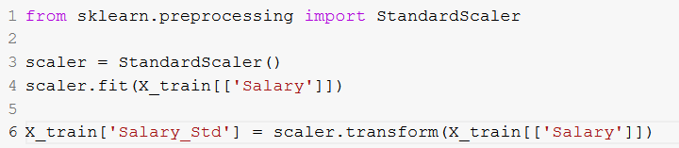
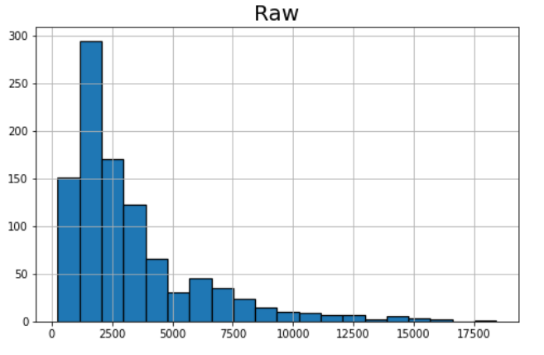
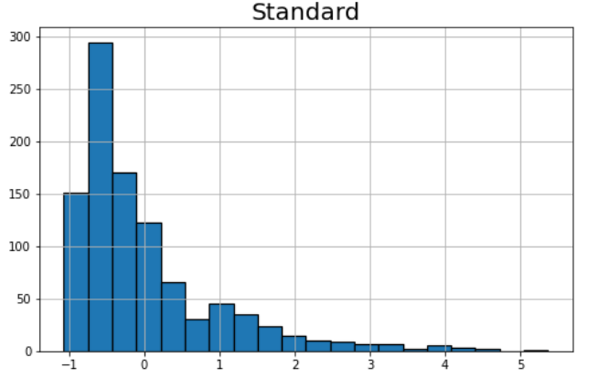

PID | Salary
29 | 6836
535 | 2319
695 | 1236
557 | 5003
836 | 886
596 | 1442
165 | 2978
918 | 2359
495 | 2996
824 | 3780
$$X_{new}=\frac{X_{old}−μ}{σ}$$
PID | Salary_Std
29 | 1.199912
535 | -0.359630
695 | -0.733547
557 | 0.567050
836 | -0.854388
596 | -0.662423
165 | -0.132103
918 | -0.345819
495 | -0.125888
824 | 0.144796

Slide 31
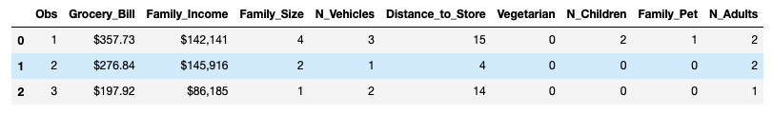
5.2 Brainstorming
Create new features with respect to domain and SME.
Exercise: Suggest new features based on the dataset below:

Slide 32
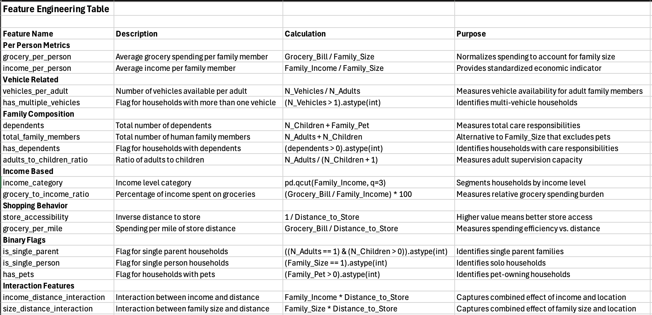
5.3 Feature Engineering: Brainstorming

